Slide 1
Time Value of Money

Slide 2
CONTENTS
Single payment series compound amount
Single payment series present worth
Equal Payment Series (Derivation)
Equal Payment Series Compound Amount factor (F/A)

Slide 3
Cash flow patterns
Single payment
Uniform payment/ Equal payment
Linear Gradient series

Slide 4
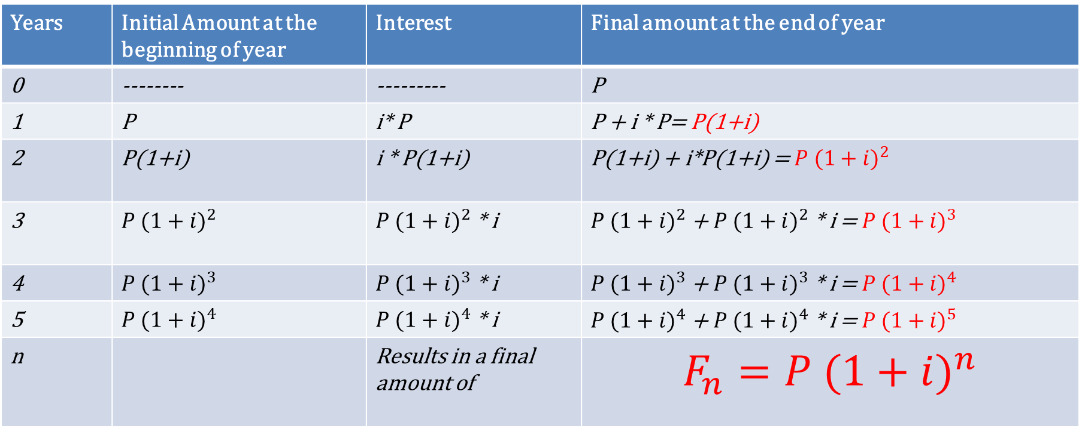
Compound Interest
Years | Initial Amount at the beginning of year | Interest | Final amount at the end of year
0 | -------- | --------- | P
1 | P | i* P | P + i * P= P(1+i)
2 | P(1+i) | i * P(1+i) | P(1+i) + i*P(1+i) = $P {(1+i)}^{2}$
3 | $$P {(1+i)}^{2}$$ | $P {(1+i)}^{2}$ * i | $P {(1+i)}^{2}$ + $P {(1+i)}^{2}$ * i = $P {(1+i)}^{3}$
4 | $$P {(1+i)}^{3}$$ | $P {(1+i)}^{3}$ * i | $P {(1+i)}^{3}$ + $P {(1+i)}^{3}$ * i = $P {(1+i)}^{4}$
5 | $$P {(1+i)}^{4}$$ | $P {(1+i)}^{4}$ * i | $P {(1+i)}^{4}$ + $P {(1+i)}^{4}$ * i = $P {(1+i)}^{5}$
n |  | Results in a final amount of | $$F_{n}=P {(1+i)}^{n}$$

Slide 5
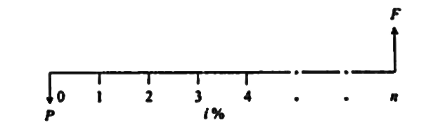
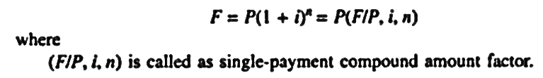
Types of Compound Interest Formulas
1. Single payment compound amount:
Here the objective is to find the single future sum (F) of initial payment P after n period at interest rate i % compounded every period.

Slide 6
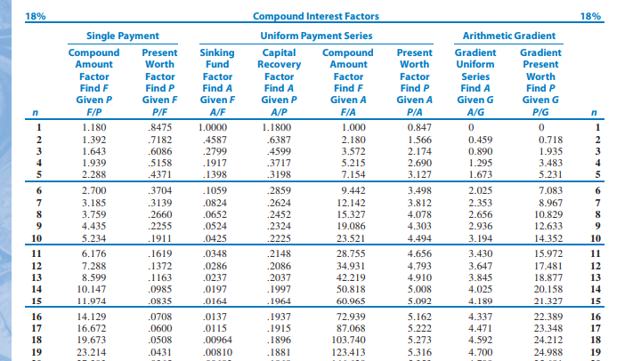

Slide 7
How much money will be accumulated in 25 years if Rs. 2400 is deposited six years from now, and Rs. 3300 is deposited 8 years from now, at an interest rate of 18 % p.a.?

Slide 8
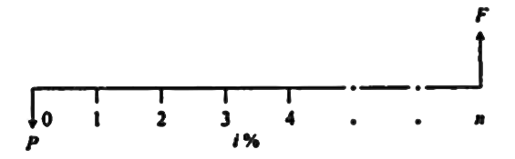
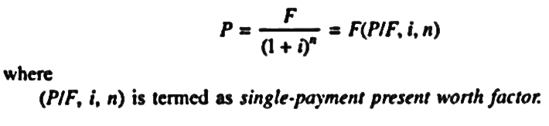
Types of Compound Interest Formulas
2. Single Payment Present Worth Amount:
Here the objective is to find the present worth amount (P) of a single future sum (F) which will be received after n periods at an interest rate of i% compounded at the end of every interest period.

Slide 9
How much must be invested now at 16% compounded annually so that $1,811 can be received 4 years hence?

Slide 10
To find i:
Suppose you buy a share of stock for $20 and sell it for $40. If this happens within a year then your i = 100%. If it takes 5 years, what is the rate of return on your investment?

Slide 11
To find n:
You just purchased 100 shares of Citi group stock at $60/ share. You will sell the stock when market price is doubled. If you expect the stock price to increase 20% per year, how long do you anticipate waiting before selling the stock?

Slide 12
Wilson technology, wishes to set aside money now to invest over the next 4 years to use to automate its customer service department. The company can earn an interest at 10% on the lump sum deposited now and it wishes to withdraw the money in the following increments. • Year 1: $25,000 to purchase a computer • Year 2: $3000 to purchase additional hardware • Year 3: No expenses • Year 4: $5000 to purchase s/w upgrades. How much money must be deposited now to cover anticipated expenses over next 4 years?

Slide 13
Practice exercises
TVM at different points in time
Varying interest rates

Slide 14
Equal payment series

Slide 15
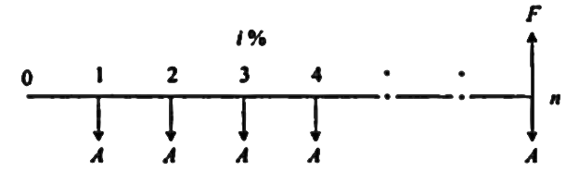
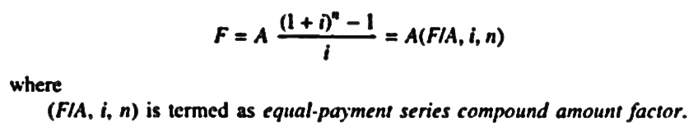
Types of Compound Interest Formulas
1. Equal Payment Series Compound Amount:
Here the objective is to find the future worth of n equal payments which are made at the end of every interest period till the end of nth interest period at an interest rate of i % compounded at the end of each interest period.

Slide 16
Suppose you make an annual contribution of $3000 to your savings account at the end of each year for 10 years. If the account earns 7% interest annually, how much can be withdrawn at the end of 10 years?
Suppose the ten deposits were made at the beginning of each period, what is the balance at the end of period 10?

Slide 17
Consider 3 investment plans for an individual who just celebrated his 24th birthday. (i= 8%).
Invest $2000 per year for first 10 years. At the end of 10 years make no further investments, but reinvest the amount for next 30 years.
Do nothing for first 10 years. Then start investing $2000/year for the next 30 years.
Invest $2000/ year for the entire 40 years.
Note that all investments are made at the birthday of each year, the first deposit will be made on 25th birthday (n=1).
Calculate the balance as on 64th birthday.

Slide 18
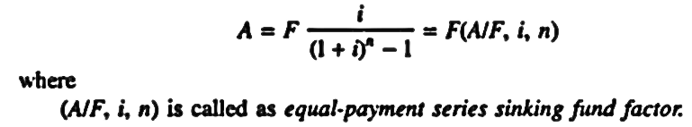
Types of Compound Interest Formulas
2. Equal Payment Series Sinking Fund:
Here the objective is to find the equal amount (A) that should be deposited at the end of every interest period for n period to realize a future sum (F) at the end of nth period at an interest rate of i %.

Slide 19
A small firm requires $200,000, 8 years from now, for the upgrade of its plant. It is willing to invest an equal amount per year from 1 to 3 (EOY 1 to EOY3), and double the instalment amount from years 5 to 7 (EOY 5 to EOY7). what are the investments to be made? Assume an interest rate of 10 percent per year.

Slide 20
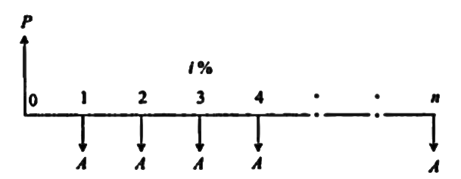
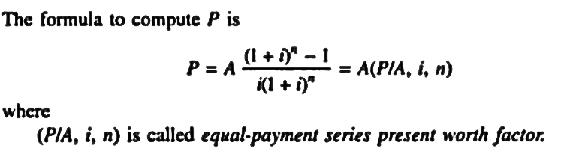
Types of Compound Interest Formulas
5. Equal Payment Series Present Worth:
Objective is to the find present worth of an equal payment made at end of every interest period for n periods.

Slide 21
Solved Problems
Determine the amount P that you should deposit into an account 2 years from now, in order to be able to withdraw Rs. 4000/- per year for 5 years starting 3 years from now, at an interest rate of 15% per year ? Also find the investment’s current value?
P = ? ; i = 15% ; n=5 ; A= 4000 ;
Notation: P= A(P/A, i, n) = 4000 * (P/A, 15, 5) = 4000 * (3.3522) = Rs 13408.80/-
P1 = P (P/F, 15%, 2) = Rs13408.8 *0.7561 = Rs10138.39
i= 15% n=5 years
4000
4000
4000
4000
4000
0
1
2
3
4
5
6
7
8
P1
P

